Slide 1
Chapter 8 – Transport in Humans

Slide 2
8.1 The Importance of a Transport System
You should be able to:
■ explain the need for transport systems in large, multicellular organisms; and
■ identify the types of materials which need to be transported in animals.

Slide 3
8.1 The Importance of a Transport System
Importance of a Transport System
All living organisms to exchange materials between
themselves and the environment.
Cells need a constant supply of nutrients and oxygen and they need to remove the waste products as well.
The table in the next slide shows some substances that needs to be transported in the human body.

Slide 4
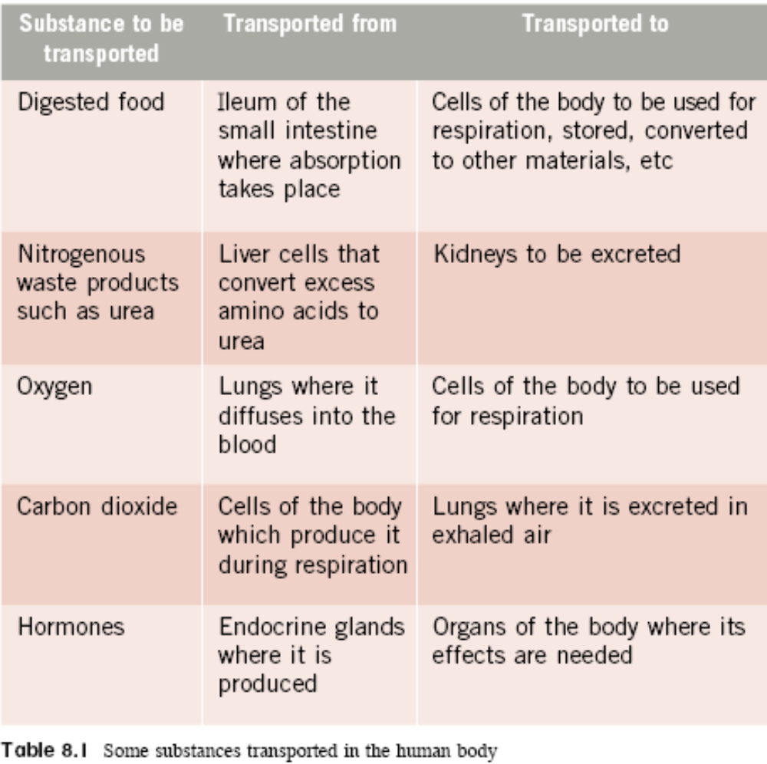
8.1 The Importance of a Transport System

Slide 5
8.1 The Importance of a Transport System
Importance of a Transport System
The Amoeba and jellyfish have a small volume in relation to their surface area. This means that the cell contents in their body are located very near to the surrounding environment.
In such organisms, exchange of materials takes place over the surface of the body by diffusion (see Chapter 4) and are transported to all the cells of the organism.
The close proximity of the cells to the surrounding environment ensures that the speed of supply of nutrients and removal of waste products is sufficient to meet the needs of the organism.

Slide 6
8.1 The Importance of a Transport System
Importance of a Transport System
In large, multicellular organisms, cells are located far away from the surrounding environment as they have a large volume in relation to their surface area.
Diffusion alone will take too long to transport materials from the air to all cells as many cells are found deep in the body.

Slide 7
8.1 The Importance of a Transport System
Importance of a Transport System
A transport system is thus needed to transport materials from one part of the body to another.
Also water moves into cells by osmosis from a solution of a higher osmotic potential (higher water concentration) to a solution of a lower osmotic potential (lower water concentration).
Cells therefore have an upper limit to their size.

Slide 8
8.2 The Circulatory System in Man
You should be able to:
■ describe the structure and function of the heart;
■ describe the structure and function of the blood vessels;
■ list the names of blood vessels supplying blood to the major organs; and
■ describe the composition and functions of blood in transport.

Slide 9
8.2 The Circulatory System in Man
The Circulatory System in Man
The human circulatory system is made up of three parts:
• Blood, which flows through blood vessels and contains materials to be transported
• The blood vessels, which are a system of interconnecting tubes that run throughout the entire body
• The heart, which acts as a muscular pump to keep the blood flowing through the blood vessels

Slide 10
8.2 The Circulatory System in Man
The Structure of the Heart
The heart is located behind the sternum (breastbone) and between the two lungs. It is made up of a unique type of muscle called cardiac muscle.
The heart is covered by a tough membrane called the pericardium, which contains pericardial fluid. This lubricates the heart against the membrane as it is beating.

Slide 11
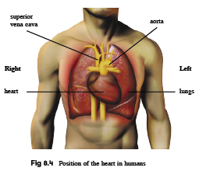

Slide 12
8.2 The Circulatory System in Man
The Structure of the Heart
On the surface of the heart, blood vessels called the coronary arteries can be seen.
These arteries transport glucose and oxygen to the cardiac muscles for respiration to produce energy.

Slide 13
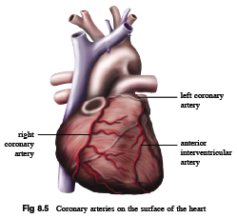
8.2 The Circulatory System in Man

Slide 14
8.2 The Circulatory System in Man
The Structure of the Heart
The mammalian heart is divided into a right and left side and are completely separated from each other by a muscular wall called the septum. Each side has two chambers.
The upper chambers on each side are called atria (singular: atrium) and the lower chambers are called ventricles.

Slide 15
8.2 The Circulatory System in Man
Each chamber is served by blood vessels that carry blood
into or away from the heart:
• The vena cava – is connected to the right atrium and brings blood back to the body. The superior (or anterior) vena cava brings blood back from the upper tissues of the body while the inferior (or posterior) vena cava brings blood back from the lower tissues of the body.
• The pulmonary artery – is connected to the right ventricle and carries blood to the lungs
• The pulmonary vein – is connected to the left atrium and brings blood back from the lungs.
• The aorta – is connected to the left ventricle and carries blood to all parts of the body except the lungs.

Slide 16
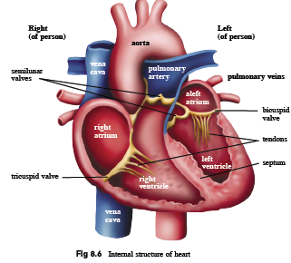
8.2 The Circulatory System in Man

Slide 17
8.2 The Circulatory System in Man
The Structure of the Heart
The atria and ventricles have valves between them called
atrioventricular valves, which prevent the backflow of
blood into the atria when the ventricles contract. They
consist of:
• the bicuspid valve which consists of two cup-shaped flaps found on the left side of the heart.
• the tricuspid valve which consists of three cup-shaped flaps found on the right side of the heart.

Slide 18
8.2 The Circulatory System in Man
The Structure of the Heart
Another set of valves called the semi-lunar valves are also found in the pulmonary arteries and aorta.
The valves prevent the backflow of blood into the ventricles when the ventricles relax.

Slide 19
8.2 The Circulatory System in Man
Flow of blood in the heart
Blood that is low in oxygen and high in carbon dioxide is called deoxygenated blood.
On the other hand, blood that is high in oxygen is called oxygenated blood.

Slide 20
8.2 The Circulatory System in Man
Flow of blood in the heart
The summary of events that occur are as follows:
On the right side of the heart:
• Deoxygenated blood from the tissues of the body returns to the right side of the heart.
• The atrium receives the blood from the vena cava and pumps it into the ventricle.
• The ventricle pumps the blood into the pulmonary artery which carries it to the lungs for gaseous exchange (see Chapter 9) to occur.

Slide 21
8.2 The Circulatory System in Man
Flow of blood in the heart
On the left side of the heart:
• Oxygenated blood from the lungs returns to the left side of the heart.
• The atrium receives the oxygenated blood from the pulmonary vein and pumps it into the ventricle.
• The ventricle pumps the blood at high pressure into the aorta which carries it to the rest of the body.
• The cycle repeats again.

Slide 22
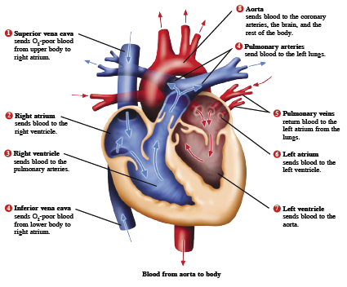

Slide 23
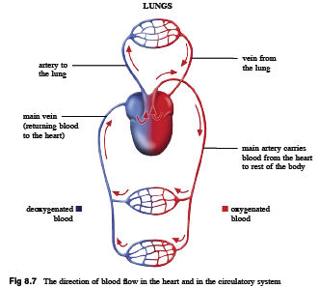

Slide 24
8.2 The Circulatory System in Man
The cardiac cycle
The cardiac cycle describes the sequence of events that occurs during one heart beat.
The heartbeat is made up of two basic components – contraction of the cardiac muscles, or systole and relaxation of the cardiac muscles, or diastole.

Slide 25
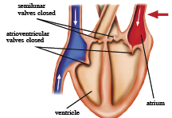
8.2 The Circulatory System in Man
The cardiac cycle
(a) Diastole – both the cardiac muscles of the atria and ventricles are relaxed. Blood returns to the atria through the vena cava and pulmonary vein. As the atria are filled with blood, pressure inside increases and pushes open the bicuspid and tricuspid valves, allowing blood to enter the ventricles.

Slide 26
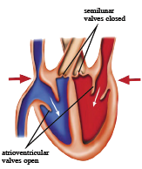
8.2 The Circulatory System in Man
The cardiac cycle
(b) Atrial systole – the cardiac muscles of the atria contract and force any remaining blood into the ventricles. The ventricles remain at diastole.

Slide 27
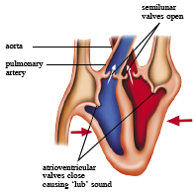
8.2 The Circulatory System in Man
The cardiac cycle
(c) Ventricular systole – the cardiac muscles of the ventricles contract and pressure inside increases. This causes the bicuspid and tricuspid valves to close to prevent backflow of blood into the atria. The semi-lunar valves open, allowing blood to enter the aorta and pulmonary arteries.

Slide 28
8.2 The Circulatory System in Man
Valves involved in the cardiac cycle:
Atrioventricular valves between the atria and ventricles prevent backflow blood into atria when ventricles contract. The ‘lub’ sound of heartbeat is produced.
Semi-lunar valves in the aorta and pulmonary artery prevent backflow of blood into ventricles when ventricles relax. The ‘dub’ sound of heartbeat is produced.

Slide 29
8.2 The Circulatory System in Man
Double circulation
Humans and other mammals and birds have a double circulatory system in which the blood passes through the heart twice in one complete circuit.
This double circulation consists of the pulmonary circulation and the systemic circulation.

Slide 30
8.2 The Circulatory System in Man
Double circulation
• In the pulmonary circulation, deoxygenated blood is pumped out of the heart to the lungs at reduced pressure. This ensures that blood flows more slowly through the lungs, giving sufficient time for the blood to be well oxygenated as well as protect delicate capillaries in the lungs.
• In the systemic circulation, oxygenated blood is pumped out of the heart to the rest of the body at increased pressure. This ensures that oxygen and nutrients are transported rapidly around the body, which is important in maintaining a high metabolic rate in mammals and birds.

Slide 31
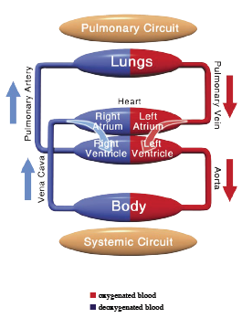

Slide 32
8.2 The Circulatory System in Man
The Structure and Function of the Blood Vessels
The blood vessels that make up the circulatory
system are of three main types:
• Arteries carry blood away from the heart.
• Veins carry blood towards the heart.
• Capillaries link arteries and veins, taking blood close to almost every cell in the body.

Slide 33
8.2 The Circulatory System in Man
Structure and function of arteries
The function of arteries is to transport blood rapidly and at high pressure, from the heart to the tissues of the body.
Arteries carry oxygenated blood, except the pulmonary arteries.

Slide 34
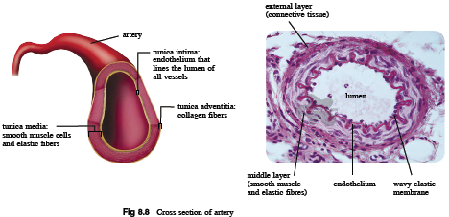
8.2 The Circulatory System in Man
Structure and function of arteries
Arteries have walls made up of three layers.

Slide 35
8.2 The Circulatory System in Man
The structure of the artery is related to its function in
the following ways:
• The artery walls are very thick. This provides strength and resilience to the walls to withstand blood at high pressure and prevent the artery from bursting.
• There is a large amount of elastic fibres in the artery walls. This allows the walls to stretch and prevent the arteries from bursting due to high pressure. This allows the walls to recoil after stretching, creating a surge of pressure to carry blood forward in a series of pulses. This ensures that blood reaches all parts of the body.

Slide 36
8.2 The Circulatory System in Man
The structure of the artery is related to its function in
the following ways:
• There are no valves except in the aorta and pulmonary artery. This is because blood leaving the heart is constantly at high pressure and does not tend to flow backwards.

Slide 37
8.2 The Circulatory System in Man
Structure and function of veins
The function of veins is to transport blood slowly under low pressure, from the tissues of the body to the heart.
Veins carry deoxygenated blood, except the pulmonary veins.

Slide 38
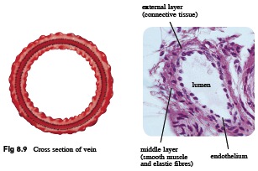
8.2 The Circulatory System in Man
Structure and function of veins
The walls of the veins are made up of the same three layers as the arteries.

Slide 39
8.2 The Circulatory System in Man
The structure of the vein is related to its function in the following ways:
• The walls are thinner containing less muscle and elastic fibres. The blood in the veins is at low pressure and so there is no risk of the vein bursting.
• There are less elastic fibres in the venous walls. The blood pressure is too low to cause any recoil action and also will not cause the veins to burst.

Slide 40
8.2 The Circulatory System in Man
The structure of the vein is related to its function in the following ways:
• There are semi-lunar valves throughout the veins. Blood at low pressure tends to flow backwards. Contractions of skeletal muscles help to push the blood along the vein by compressing against it and causing the pressure inside the veins to slightly increase. The valves ensure that blood flows in one direction only, towards the heart.

Slide 41
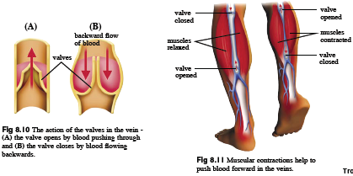
8.2 The Circulatory System in Man

Slide 42
8.2 The Circulatory System in Man
Structure and function of capillaries
As arteries reach the tissue to which they are transporting blood, they branch into smaller vessels called arterioles which branch even further into capillaries.
As blood leaves a capillary network, the capillaries gradually join to form larger vessels called venules, which join again to form veins.

Slide 43
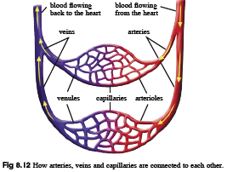
8.2 The Circulatory System in Man

Slide 44
8.2 The Circulatory System in Man
Structure and function of capillaries
The capillaries transport blood to almost all the cells of the body, and allow exchange of materials to occur between the tissue cells and blood.

Slide 45
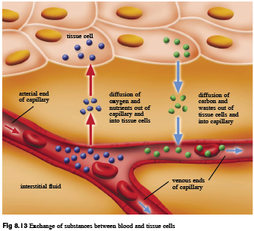

Slide 46
8.2 The Circulatory System in Man
The structure of the capillary is related to its
function in the following ways:
• The wall (endothelium) is made up of one layer of cells. This makes the capillary wall very thin which allows rapid diffusion of materials between the tissue cells and blood, as diffusion takes place over a short distance.

Slide 47
8.2 The Circulatory System in Man
The structure of the capillary is related to its
function in the following ways:
• They are numerous and highly branched. When all the internal walls of capillaries for the entire body are added up, it is huge. This therefore increases the surface area to volume ratio for exchange of materials.
• They are very narrow in diameter. This allows the capillaries to reach out to all cells in the body and bring blood to the cells.

Slide 48
8.2 The Circulatory System in Man
The structure of the capillary is related to its
function in the following ways:
• They have a very narrow lumen – around 7 μm in diameter. As blood flows through, the red blood cells are forced to line themselves in a single file and are squeezed flat against the sides of the capillary. This brings them even closer to the cells and allows rapid diffusion to take place.

Slide 49
8.2 The Circulatory System in Man
The structure of the capillary is related to its
function in the following ways:
• Blood pressure is lowered as an arteriole branches into capillaries. This slows down the flow of blood, giving sufficient time for the exchange of materials between the tissue cells and blood.

Slide 50
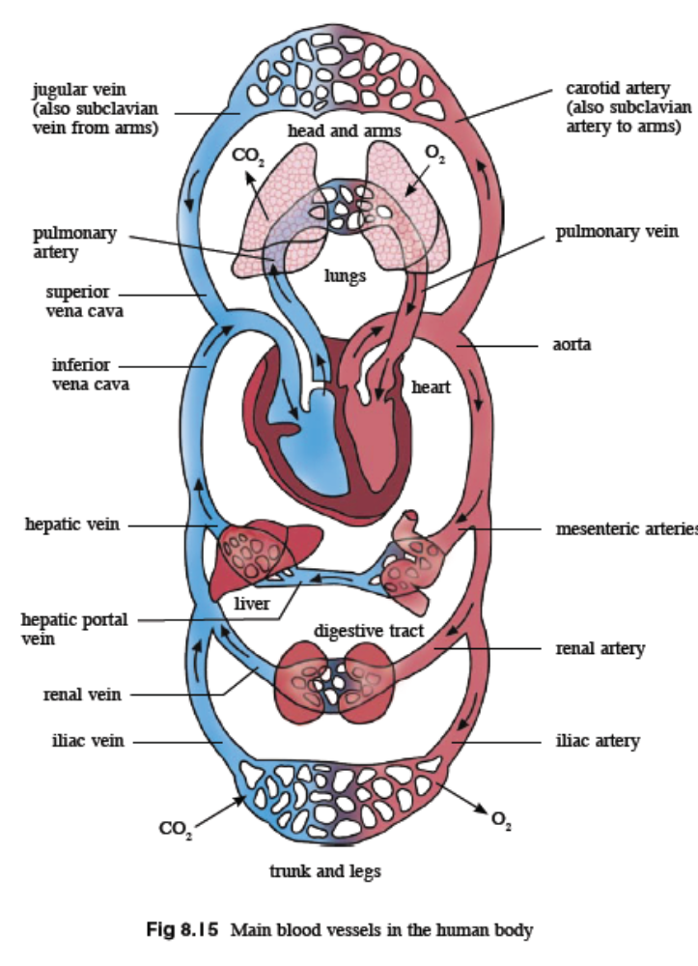
8.2 The Circulatory System in Man

Slide 51
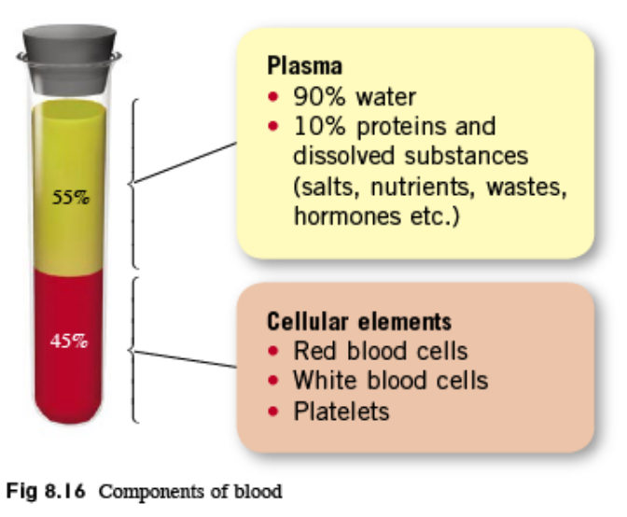
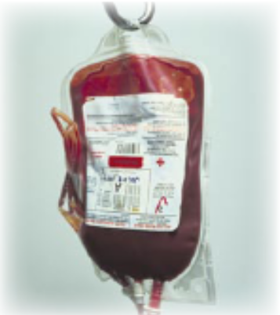
8.2 The Circulatory System in Man
Composition and Functions of Blood
Blood is the medium by which materials are transported between different parts of the body.
Humans have 4 to 5 litres of blood.
It consists of plasma (55%) and blood cells (45%) – red blood cells, white blood cells and platelets.

Slide 52
8.2 The Circulatory System in Man
Structure and function of plasma
Plasma is a pale yellow liquid in which the blood cells float. It is mainly made up of water (90%) and dissolved substances.
The function of plasma is to transport heat and dissolved substances from where they are produced or absorbed to the cells that use or excrete them.

Slide 53
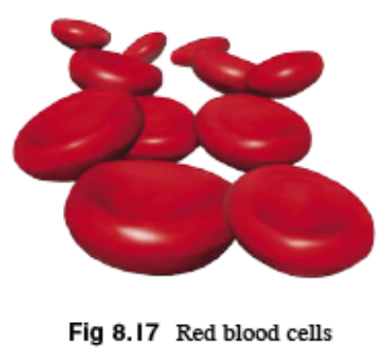
8.2 The Circulatory System in Man
Structure and function of red blood cells
Red blood cells are also called erythrocytes.
There are 5 million of them in each mm³ of blood, measuring 7-8 μm in diameter, and have a lifespan of about 120 days.
This means that the bone marrow which makes them has to make about 2 million red blood cells per second!

Slide 54
8.2 The Circulatory System in Man
Structure and function of red blood cells
Red blood cells contain a protein pigment called haemoglobin, which gives them their characteristic red colour.
Haemoglobin is responsible for transporting oxygen in the red blood cells from the lungs to respiring cells in the body.

Slide 55

8.2 The Circulatory System in Man
Structure and function of red blood cells
Oxygen binds reversibly to haemoglobin to form oxyhaemoglobin. As blood passes through tissues containing very little oxygen, the oxygen is readily given up for respiring cells to use.

Slide 56
8.2 The Circulatory System in Man
Structure and function of red blood cells
There are unusual features in the structure of the red blood
cell which gives them a shorter life-span but makes them
more efficient in their role of transporting oxygen.
• Red blood cells are shaped like a biconcave disc. This means that they are much thinner in the middle which increases their surface area to volume ratio. This allows rapid diffusion of oxygen into or out of the cell.

Slide 57
8.2 The Circulatory System in Man
Structure and function of red blood cells
• Red blood cells have no nucleus, mitochondria, rough endoplasmic reticulum or Golgi apparatus. The lack of these organelles means that there is more room for haemoglobin, which carries oxygen. This allows more oxygen to be carried by the red blood cell.
• Red blood cells are very small, and changes shape. This allows them to squeeze through the capillaries and be flattened against the capillary walls. This brings red blood cells very close to the tissue cells and allows diffusion to occur rapidly.

Slide 58
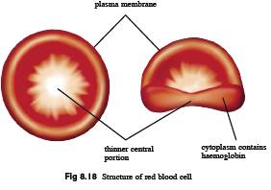
8.2 The Circulatory System in Man

Slide 59
8.2 The Circulatory System in Man
Structure and function of white blood cells
White blood cells are also called leucocytes.
There are 5000 to 10000 white blood cells in each mm³ of blood. That makes about one white blood cell to every 700 red blood cells.
White blood cells have a lifespan of one day or less and are also made in the bone marrow.

Slide 60
8.2 The Circulatory System in Man
Structure and function of white blood cells
Each white blood cell has the following features
that distinguish them from red blood cells:
• They all contain a nucleus.
• They are either spherical or irregular in shape.
• Most of them are larger than red blood cells.
• They can change shape and squeeze through the walls of capillaries into the fluid that surrounds tissue cells.

Slide 61
8.2 The Circulatory System in Man
Structure and function of white blood cells
The function of white blood cells is to protect the body
against infection. The two main types of white blood cells are:
• Phagocytes, which remove foreign particles and microorganisms such as bacteria, and dead cells through the process of phagocytosis. Phagocytes first engulf the foreign particle before ingesting and digesting it.
• Lymphocytes, which produce chemical substances called antibodies which protect us from disease-causing organisms (pathogens) by making them clump together for easier ingestion by phagocytes or by neutralizing their toxins.

Slide 62
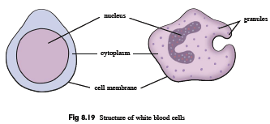
8.2 The Circulatory System in Man

Slide 63
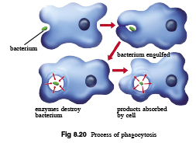
8.2 The Circulatory System in Man

Slide 64
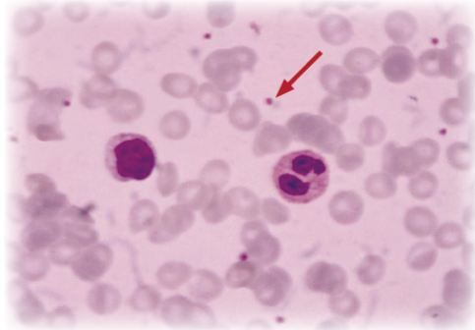
8.2 The Circulatory System in Man
Structure and function of platelets
Platelets are cell fragments which are formed when a small part of a large cell in the bone marrow breaks off.
They have a life-span of about 10 days and are very small, only about 3 μm in diameter.
Platelets do not have a nucleus, but contain mitochondria.
They play an important role in the process of blood clotting which seals off the wound to prevent excessive blood loss and entry of pathogens into the blood.

Slide 65
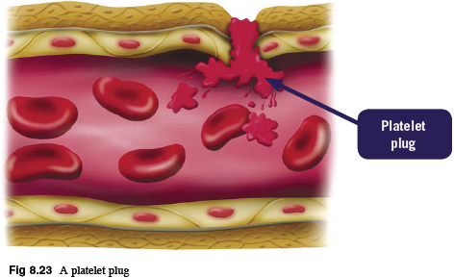
8.2 The Circulatory System in Man
Structure and function of platelets
When the skin is cut, and a small blood vessel is broken, a series of reactions occur to clot the blood.
Platelets can adhere to the walls of damaged blood vessels and swell, releasing chemicals which stimulate more platelets, resulting in a mass of sticky, swollen platelets, adhering to the damaged blood vessel wall, forming a platelet plug.

Slide 66
8.2 The Circulatory System in Man
Structure and function of platelets
A blood clot results when the soluble protein fibrinogen, which is always present in blood plasma, is converted into insoluble protein fibrin, after a series of reactions occur in the plasma.
Platelets release enzymes and chemicals called clotting factors which are necessary for these reactions to take place.
Fibrin forms a mesh of protein threads across the wound, which traps blood cells and more platelets, and the whole mass is a blood clot.

Slide 67
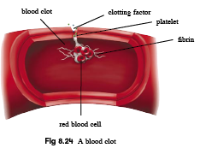
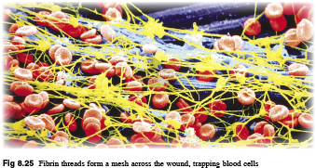

Slide 68
8.2 The Circulatory System in Man
Blood transfusions and blood groups
Mixing incompatible blood from two persons can lead to blood clumping or agglutination and can cause death.
The differences in human blood groups are due to proteins called antigens and antibodies.
The antigens are found on the surface of red blood cells and the antibodies are found in plasma.
The blood group a person belongs to depends on the types of antigens and antibodies present in the blood.
The four blood groups, are A, B, AB and O.

Slide 69
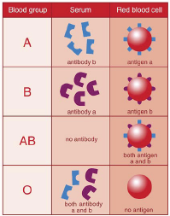
8.2 The Circulatory System in Man
The table below shows the types of antigens and antibodies present in the different blood groups.

Slide 70
8.2 The Circulatory System in Man
Blood transfusions and blood groups
What causes blood to clump?
If the blood groups between the donor and the patient are not compatible, the red blood cells from the donated blood will clump or agglutinate.
The agglutinated red cells can clog blood vessels and stop the circulation of the blood to various parts of the body.

Slide 71
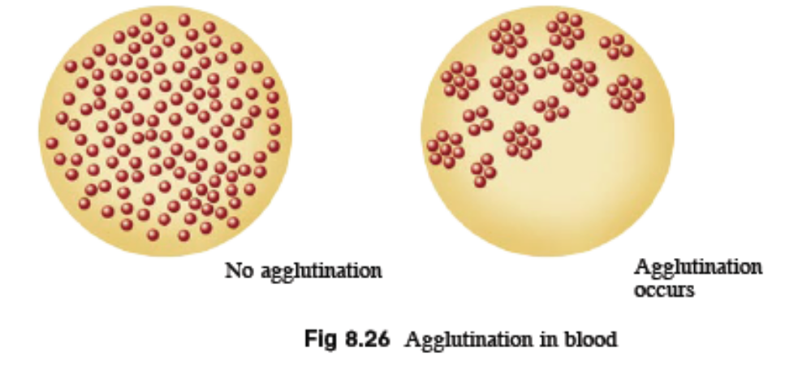
8.2 The Circulatory System in Man
Blood transfusions and blood groups
What causes blood to clump?
The patient has antibodies that will not react with the antigens on their own red blood cells, but may react with the antigens found in the donated blood.
A antibodies bind to A antigens and B antibodies bind to the B antigens.

Slide 72
8.2 The Circulatory System in Man
Blood transfusions and blood groups
What blood groups are compatible?
A patient can always receive blood from someone who has the same blood type as his.
There are also certain blood groups which are compatible with other blood groups.
Blood clumping will not occur as long as the person who is receiving the blood does not have any antibodies that will bind with the donor blood’s antigens.

Slide 73
8.2 The Circulatory System in Man
Blood transfusions and blood groups
What blood groups are compatible?
People with blood group O are considered ‘universal donors’ because their blood can be transfused into any other blood group.
The recipient’s antibodies will not cause blood clumping as blood group O does not have any antigens on the red blood cells.

Slide 74
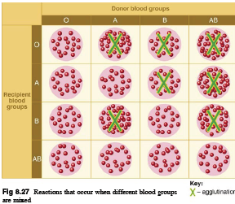
8.2 The Circulatory System in Man

Slide 75
8.2 The Circulatory System in Man
Hypertension
Blood pressure is a force that blood exerts on the walls of blood vessels.
It can be measured using a sphygmomanometer.
Blood pressure is measured in terms of millimetres (mm) of mercury (Hg) and recorded as systolic and diastolic pressure.
Systolic pressure: blood pressure in arteries during ventricular systole
Diastolic pressure: blood pressure in arteries during ventricular diastole

Slide 76
8.2 The Circulatory System in Man
Hypertension
At rest, the normal blood pressure in humans is 120-140 mmHg (systolic) and 80-90 mmHg (diastolic).
Blood pressure varies from person to person; it increases with age and changes temporarily during periods of physical activity, emotions, rest and sleep.
A person with systolic pressure of 160 mmHg and diastolic pressure of 95 mmHg is considered to have hypertension.

Slide 77
8.2 The Circulatory System in Man
Hypertension
Factors that increase the risk of hypertension are:
Tobacco smoking
Emotional stress
Lack of exercise
Obesity
Excessive alcohol intake
A diet high in salt or cholesterol
Genetic predisposition

Slide 78
Key Concepts
Structure and function of the heart
The mammalian heart is made up of cardiac muscle. It is made up of two thin-walled chambers called the atria and another two thick muscular walled chambers called the ventricles.
The left ventricle has thicker walls than the right ventricle.
The septum separates the left and right chambers of the heart.
Between the chambers, on the left side of the heart are the bicuspid valves, while those on the right side of the heart are called tricuspid valves.

Slide 79
Key Concepts
Structure and function of the heart
Oxygen and nutrients is essential to the heart muscle and are supplied by the coronary arteries.
In the pulmonary circulation, deoxygenated blood from the body flows into the heart and is pumped to the lungs.
In the systemic circulation, oxygenated blood returns from the lungs to the heart and is pumped to the rest of the body.
Ventricular systole is when the ventricles contract and ventricular diastole is when the ventricles relax.

Slide 80
Key Concepts
Structure and function of the heart
A heartbeat consists of a ventricular systole and diastole.
The atrioventricular valves prevent backflow of blood into the atria during ventricular systole.
Semi lunar valves in the aorta and pulmonary arteries prevent backflow of blood into the ventricles during ventricular diastole.

Slide 81
Key Concepts
Structure and function of the blood vessels
Arteries are the blood vessels which carry blood away from the heart. They have very thick muscular walls to withstand the high blood pressure as are forced out of the heart. The walls are also elastic to enable the wall to stretch and recoil.
Semi lunar valves are absent in the arteries except in the aorta and pulmonary arteries.
Veins are the blood vessels which carry blood back to the heart. They have thinner walls as blood pressure is low. Instead they contain valves which prevent the backflow of blood. The contraction of skeletal muscles compresses the veins and helps in the flow of blood.

Slide 82
Key Concepts
Structure and function of the blood vessels
Semi lunar valves are present in the veins except in the pulmonary veins.
Capillaries are microscopic thin walled blood vessels which carry blood from arterioles to venules. They branch repeatedly to form networks and are found between the cells of body tissues to allow exchange of substances between blood and tissue cells.

Slide 83
Key Concepts
Structure and functions of blood
Blood is made up of a liquid called plasma, composed mainly of water, it functions as a transport medium of many dissolved materials and the blood cells.
The most numerous cells found in blood are the red blood cells, which are biconcave discs and contain a red pigment called haemoglobin, which binds reversibly to oxygen.
The second type of cells is the white blood cells, which exist in a variety of forms. They all contain a nucleus, which makes them different from the other cells found in blood.

Slide 84
Key Concepts
Structure and functions of blood
White blood cells that engulf bacteria are called phagocytes, and those that secrete chemicals called antibodies are known as lymphocytes.
Blood also contains platelets which are responsible for clotting of blood. During blood clotting, the soluble plasma protein called fibrinogen, is converted into insoluble protein called fibrin which forms a mesh to trap blood cells.
Red blood cells, white blood cells and platelets are produced in the bone marrow.

